Slide 1
Software Defined Networking (SDN)
Chapters 4 and 10
Panko and Panko
Business Data Networks and Security
Copyright © 2016 Pearson Education, Inc.

Slide 2
4.19 Traditional Device Control in Networking
Control
Forwarding
Creating policies and rules for forwarding frames or packets
Creating the switching/routing table
Usually done only occasionally
Using the switching/routing table to make forwarding decisions
Done thousands or millions of times per second

Slide 3
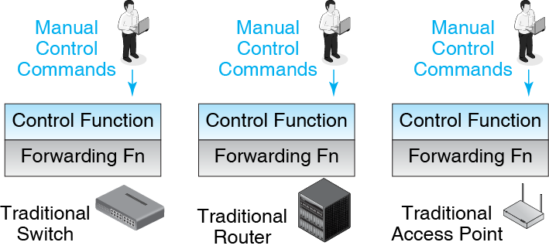
4.20 Traditional Device Control in Networking
Combined
Both forwarding and control were managed on each device separately

Slide 4
4.20 Traditional Device Control in Networking
Each device must be managed manually and individually

Slide 5
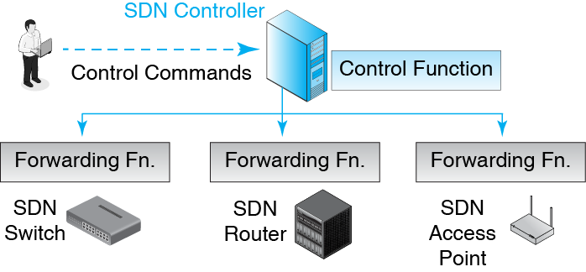
4.21 Software-Defined Networking (SDN) Control
Control is centralized and
Immediately changeable
Forwarding remains distributed on individual devices

Slide 6
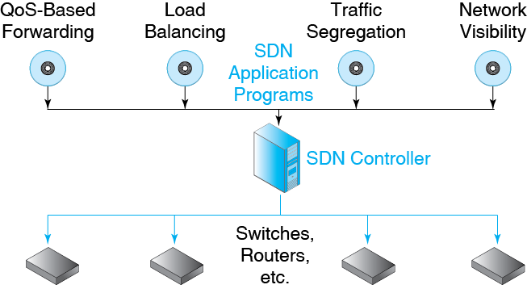
4.22: SDN Application Programs
SDN Application Programs partially or fully automate SDN controller actions.

Slide 7
SDN Benefits
Cost reduction
When changes are made, every device does not have to have its control function changed manually
Changes are speeded by SDN applications
Devices have no control functions, so cheaper
Agility
Changes can be made immediately to respond to changing conditions

Slide 8
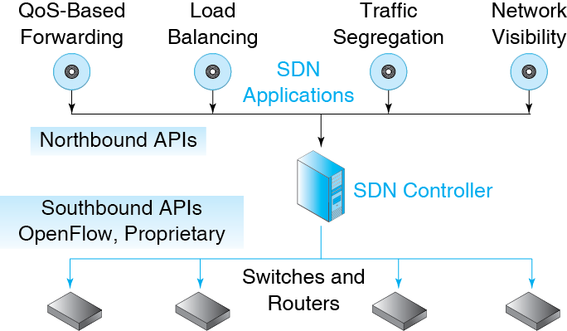
10.22: Software-Defined Networking (SDN)
SDN applications are critical to SDN success.

Slide 9
10.22: Software-Defined Networking (SDN)
Application Program Interfaces (APIs)
Standard interfaces to programs.

Slide 10
10.22: SDN Forwarding Table Rules
Row | IP Src Addr | IP Dest Addr | TCP Dest Port | Ethernet Priority | IP Class Number | Action
1 | External | 128.3.2.8 | 443 | 7 | Any | Pass with Priority
2 | External | 128.3.2.8 | 443 | Any | 17 | Pass Apply Class Rule 17
3 | External | 128.3.2.8 | 443 | Any | Any | Drop
4 | Not Finance | Finance | Any | Any | Any | Drop Log
5 | Internal | 128.7.65.1 | 443 | Any | Any | Authenticate
6 | Internal | External | 80 | Any | Any | Drop
7 | Internal | External | 443 | Any | Any | Pass
8 | Any | Honeypot | Any | Any | Any | Pass Alarm
What do the first three rules do together?
Port 443 is HTTP over SSL/TLS (https)

Slide 11
10.22: SDN Forwarding Table Rules
Row | IP Src Addr | IP Dest Addr | TCP Dest Port | Ethernet Priority | IP Class Number | Action
1 | External | 128.3.2.8 | 443 | 7 | Any | Pass with Priority
2 | External | 128.3.2.8 | 443 | Any | 17 | Pass Apply Class Rule 17
3 | External | 128.3.2.8 | 443 | Any | Any | Drop
4 | Not Finance | Finance | Any | Any | Any | Drop Log
5 | Internal | 128.7.65.1 | 443 | Any | Any | Authenticate
6 | Internal | External | 80 | Any | Any | Drop
7 | Internal | External | 443 | Any | Any | Pass
8 | Any | Honeypot | Any | Any | Any | Pass, Alarm
What do Rules 4 through 8 do?

